Slide 1

Dynamic Index Coding
Packet set P
Broadcast
Station
1
2
3
4
5
1
2
3
1
2
N
User set N
Michael J. Neely , Arash Saber Tehrani , Zhen Zhang
University of Southern California
Paper available at: (i) http://www-bcf.usc.edu/~mjneely/ (ii) http://arxiv.org/abs/1108.1977

Slide 2
Motivation
Packet set P
1
2
3
4
5
BS
1
2
N
User set N
1
2
3
Want to expand wireless throughput.
Wireless users download popular files.
Some users already have the files in cache.
Can we push information theory and
network theory to exploit this side info?

Slide 3
Simple Model
Packet set P
1
2
3
4
5
BS
1
2
N
User set N
1
2
3
N users. P packets in Broadcast Station (BS).
Each user wants a different subset of packets.
Each user already has a different subset
of packets in its cache.
BS can transmit 1 packet/slot.
All users successfully hear all BS transmissions.

Slide 4
Can we finish in less than P slots?
Example 1:
BS
Want: A
Want: B
Have: B
Have: A
User 1
User 2

Slide 5
Can we finish in less than P slots?
Example 1:
BS
Efficiency Ratio = 2:1
A
+
B
Want: A
Want: B
Have: B
Have: A
User 1
User 2

Slide 6
Can we finish in less than P slots?
Example 2:
BS
Want: A
Want: B
Want: C
Have: B C
Have: A C
Have: A B
User 1
User 2
User 3

Slide 7
Can we finish in less than P slots?
Example 2:
BS
Efficiency Ratio = 3:1
A
+
B
+
C
Want: A
Want: B
Want: C
Have: B C
Have: A C
Have: A B
User 1
User 2
User 3

Slide 8
K-Cycle Coding Actions
User 2
Want: A
Have: B
User 1
Want: D
Have: A
Message 1: A + B
Message 2: B + C
Message 3: C + D
User 3
Want: B
Have: C
Want: C
Have: D
User 4
Clears K packets in K-1 slots
(efficiency ratio = K : K-1 )

Slide 9
Minimum Clearance Time T_{min}
Unsolved Info Theory Problem!
Even Restricting to Linear Codes is NP Hard!
What can we say?

Slide 10
Information Theory Result
*Theorem 1: If the bipartite demand graph is acyclic, then T_{min}= P.
Packet set P
1
2
3
4
5
User set N
1
2
3
*Extends [Bar-Yossef, Birk, Jayram, Kol 2011] to the case of general demand graphs.

Slide 11
Information Theory Result
*Theorem 1: If the bipartite demand graph is acyclic, then T_{min}= P.
Packet set P
Cor 1: Need cycles for coding to help.
Cor 2: Max acyclic subgraph bound.
1
2
3
4
5
User set N
1
2
3
*Extends [Bar-Yossef, Birk, Jayram, Kol 2011] to the case of general demand graphs.

Slide 12
Dynamic Index Coding
Packets arrive randomly, rates (λ₁, …, λ_{M}).
A = Abstract space of coding options.
example: A = {Cyclic coding actions}.
Each code action α in A has:
T(α) = frame size of action α.
(μ₁(α), …, μ_{M}(α)) = clearance vector of action α.
Frame 1
Frame 2
Frame 3
T(α[1])
T(α[2])
T(α[3])
time

Slide 13
Max-Weight Code Selection Algorithm
Every new frame k, observe queues (Q₁[k], …, Q_{M}[k])
Then choose code action α[k] in A to maximize:
∑_{m} Q_{m}[k] [μ_{m}(α[k])/T(α[k])]
Theorem 2: This alg supports any rate vector (λ₁, …, λ_{M})
in the Code-Constrained Capacity region Λ_{A.}
(where Λ_{A} is optimal region subject to using codes in set A).

Slide 14
Simulation of Max-Weight Code Selection
Max-Weight
Details: 3 user system. Each user has packets arriving rate λ. Each packet is independently
in cache of another user with prob ½. Total number of traffic types = M = 12.

Slide 15
Question
When does Λ_{A} = Λ ?
Λ_{A} = Code constrained capacity region
Λ = Capacity region (info theory)

Slide 16
Special case of Broadcast Relay Networks:
Users want to send to other users via Broadcast Relay.
Each packet contained as side info in exactly one user.
Each packet has exactly one user as destination.
Admits a simplified graphical structure with user nodes only. We can often compute T_{min}.

Slide 17
Results for N-user Broadcast Relay Nets:
Algorithm: Max-Weight Code Selection with Cyclic Coding.
This is information-theoretically optimal in these cases:
N=2 (Λ is 2-dimensional)
N=3 (Λ is 6-dimensional)
Any N, provided that either:
(i) Each user sends to at most one other user.
(ii) Each user receives from at most one other
user.

Slide 18
Conclusions
Packet set P
1
2
3
4
5
BS
1
2
N
User set N
1
2
3
Acyclic Graph Theorem.
Dynamic Index Coding Exploits Cycles.
Achieves Code Constrained Capacity Region.
Achieves Info Theory Capacity Region for Classes of Broadcast Relay Networks.
This is a new example of a consummated union between Information Theory and Networking.

Slide 19
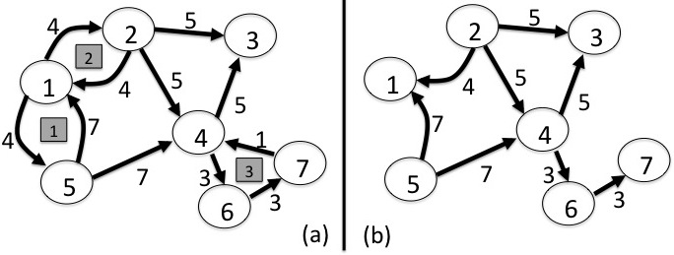
Special case of Broadcast Relay Networks:
Admits a simplified graphical structure, can often compute T_{min}.
(nodes = users, links labeled by # packets)
7 users
48 packets
Tmin = 39
Graph with 3 disjoint cycles
Max Acyclic Subgraph

